Slide 1
Planning & Scoping Cost Estimates
(and also some Highway Design updates)
Steve De Witte & Patrick Perry
September 6, 2023

Slide 2
​THE KYTC MISSION
To provide a safe, efficient, environmentally sound and fiscally responsible transportation system that delivers economic opportunity and enhances the quality of life in Kentucky

Slide 3
What is a cost estimate?

Slide 4
TYPES OF COST ESTIMATES

Slide 5
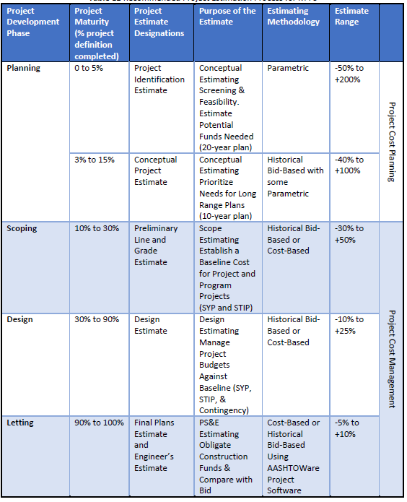
RESEARCH
ABSTRACT
DESIGN

Slide 6
RESEARCH
ABSTRACT
DESIGN

Slide 7
RESEARCH
ABSTRACT
DESIGN

Slide 8
RESEARCH
ABSTRACT
DESIGN

Slide 9
RESEARCH
ABSTRACT
DESIGN

Slide 10
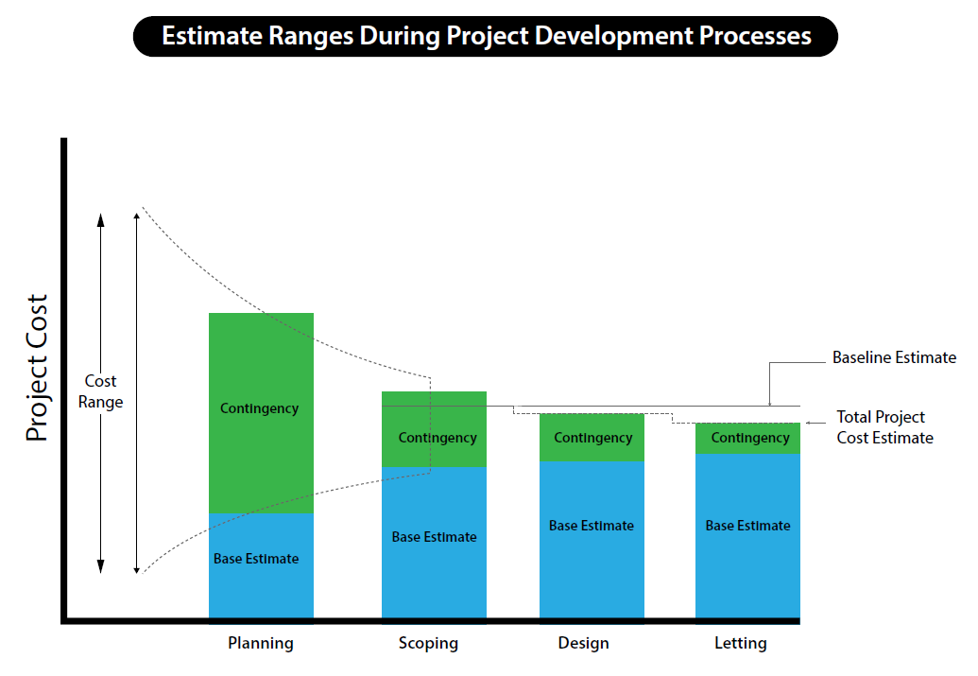

Slide 11
WHY ARE COST ESTIMATES IMPORTANT?

Slide 12
​THE KYTC MISSION
To provide a safe, efficient, environmentally sound and fiscally responsible transportation system that delivers economic opportunity and enhances the quality of life in Kentucky

Slide 13
“The journey is the safest when the roadmap is the clearest.”
RESEARCH
ABSTRACT
DESIGN

Slide 14
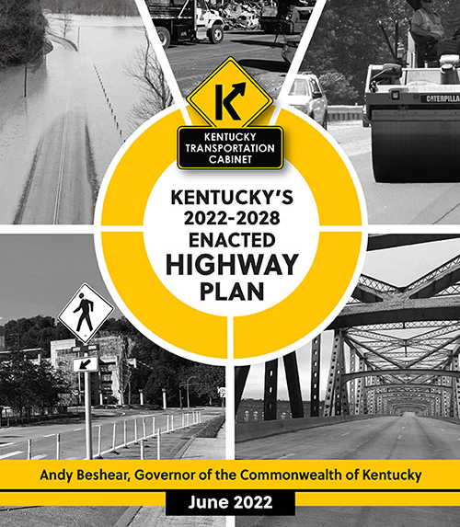
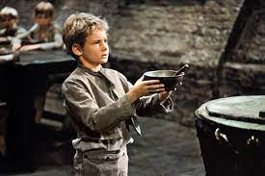
RESEARCH
ABSTRACT
DESIGN
Notes:
What happens now, low-ball estimates, plan gets overloaded, ask for more money multiple times

Slide 15
Planning and scoping estimates

Slide 16
RESEARCH
ABSTRACT
DESIGN

Slide 17
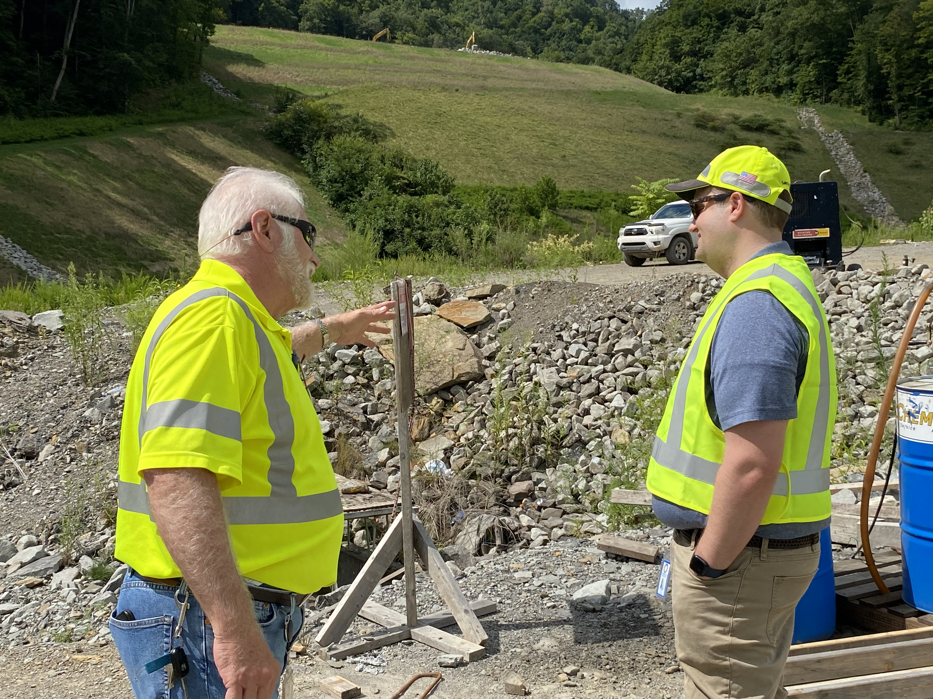

Slide 19
PROJECT IDENTIFICATION ESTIMATES

Slide 20
Project Maturity | Estimating Methodology | Estimate Range | Level of Effort
0 to 5% | Parametric | -50% to +200% | Low
Examples:
SWCP/SWIPP
“YUM Center”
Initial CHAF Estimate
Contingency
Gigantic
RESEARCH
ABSTRACT
DESIGN
Sources of Risk:
Lack of Project Definition

Slide 21
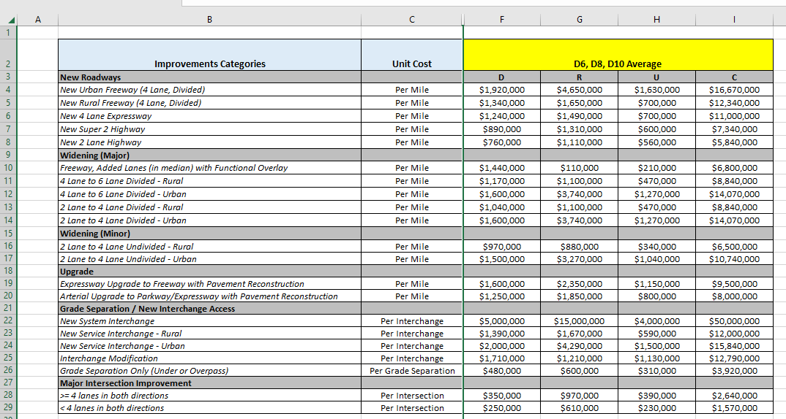
RESEARCH
ABSTRACT
DESIGN

Slide 22
CONCEPTUAL PROJECT ESTIMATES

Slide 23
Project Maturity | Estimating Methodology | Estimate Range | Level of Effort
3% to 15% | Historical Bid-Based with some Parametric | -40% to +100% | Medium
Bid-Based
Excavation/Embankment
Asphalt Base/Surface
DGA
Concrete
Curb & Cutter
Sidewalk
Parametric
Structures
Mob/Demob
MOT
Contingency
Depends on Complexity
RESEARCH
ABSTRACT
DESIGN

Slide 24
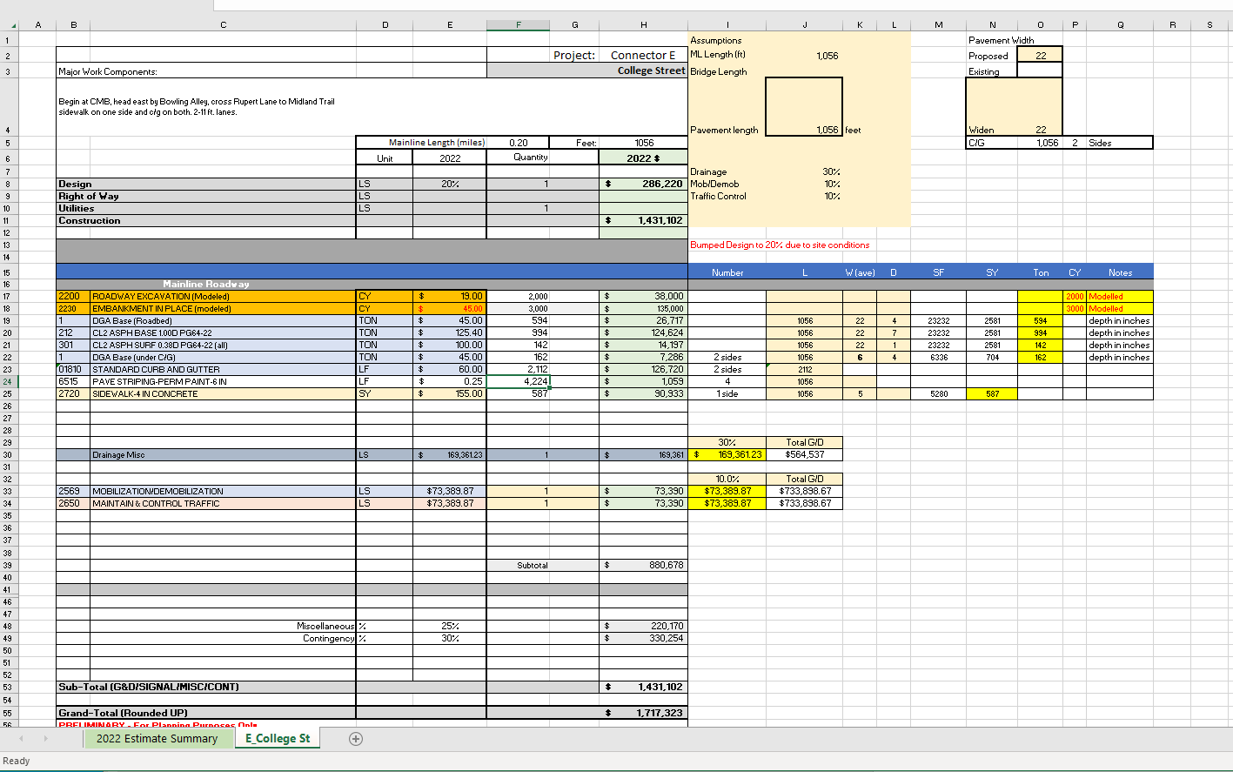
RESEARCH
ABSTRACT
DESIGN

Slide 25
Project Maturity | Estimating Methodology | Estimate Range | Level of Effort
3% to 15% | Historical Bid-Based with some Parametric | -40% to +100% | Medium
Examples:
Most Planning Studies
RESEARCH
ABSTRACT
DESIGN
Sources of Risk:
Known Unknowns
Environmental
ROW/Utilities
Geotech
Structures
Drainage
Unknown Unknowns
Inflation of bid items
Availability of Materials
Labor Cost

Slide 26
Don’t take THE “ROSY” PATH
“We should have good rock.”
“We can reuse pavement in this section.”
RESEARCH
ABSTRACT
“ROW will be donated.”
Ok to assume absolutely nothing is going to go right!

Slide 27
Bid Items
Pavement
Excavation
Parametric
Other Phases
Drainage/MOT/Mobilization
Contingencies
Remember all those risks? Account for them
Curb/Gutter/Sidewalk
Miscellaneous

Slide 28
PRELIMINARY LINE AND GRADE ESTIMATE

Slide 29
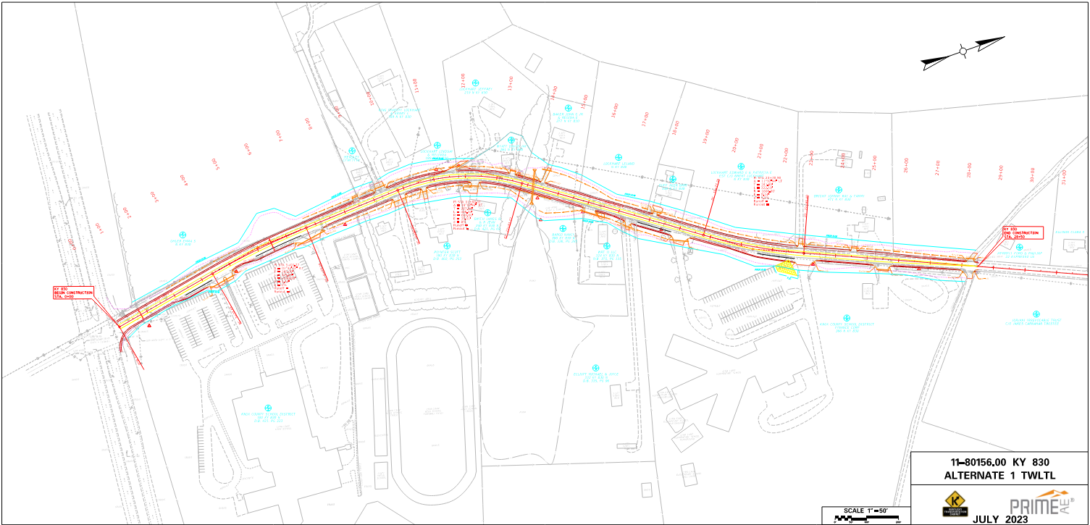
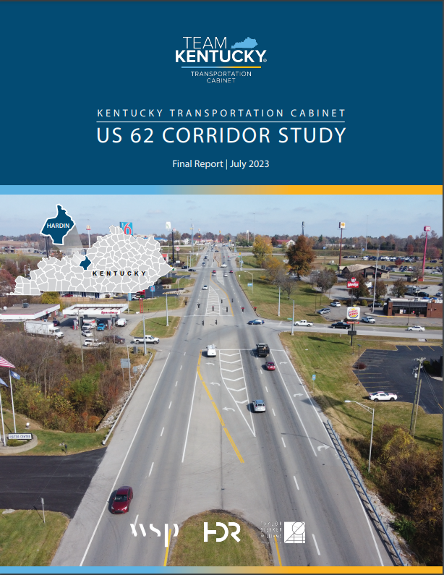
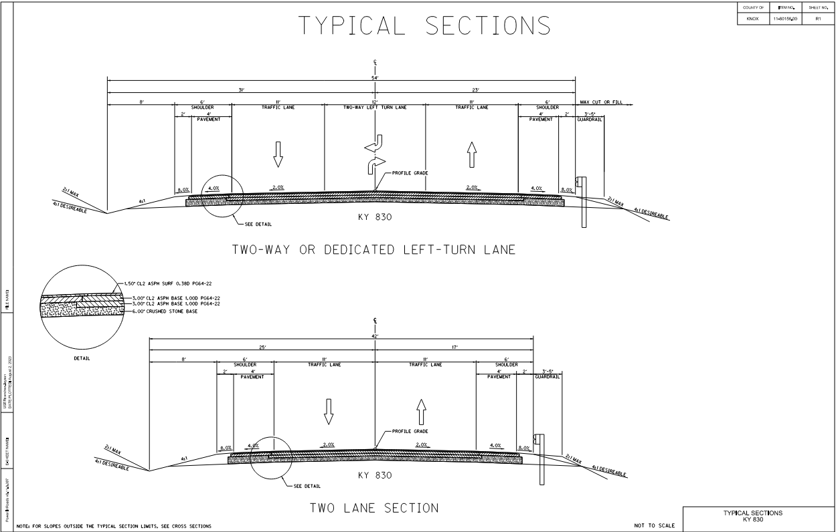
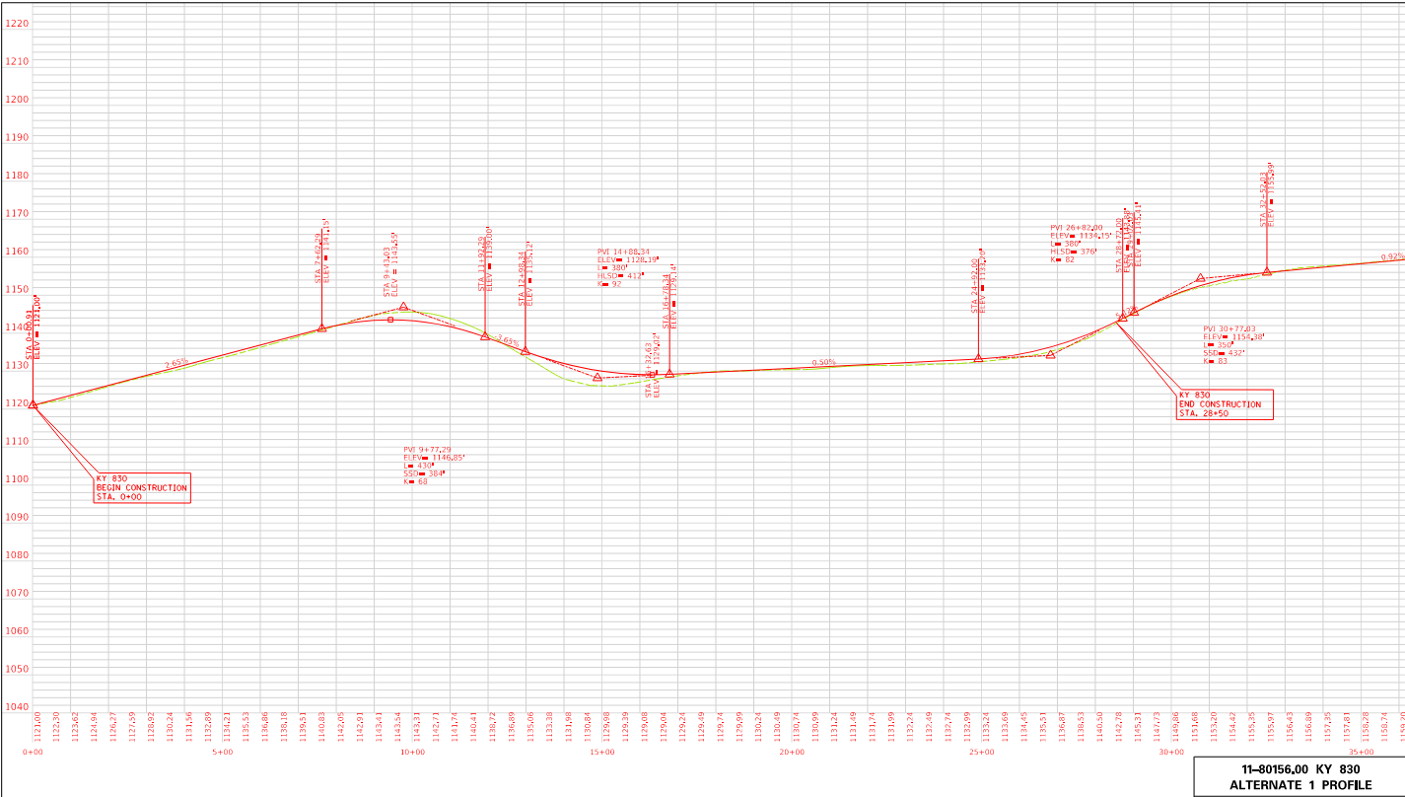
Turn This:
Into This:
RESEARCH
ABSTRACT

Slide 30
Project Maturity | Estimating Methodology | Estimate Range | Level of Effort
10% to 30% | Historical Bid-Based or Cost-Based | -30% to +50% | High
Examples:
Fully scoped projects (“Design” projects)
RESEARCH
ABSTRACT
DESIGN
Sources of Risk:
ROW/Utilities
Lighting

Slide 31
Improvements to the process

Slide 32
COST ESCALATION

Slide 33
Need to account for TIME contingency
If we started a Planning study today, we’re already into the next biennium for Design.
+10%
RESEARCH
ABSTRACT
DESIGN

Slide 34
Need to account for TIME contingency
Design and Environmental will take 2 years.
+20%
RESEARCH
ABSTRACT
DESIGN
TOTAL: +30%

Slide 35
Need to account for TIME contingency
Utilities and Right-of-Way will take 2 years.
+20%
RESEARCH
ABSTRACT
DESIGN
TOTAL: +50%

Slide 36
Bid Items
Pavement
Excavation
Parametric
Other Phases
Drainage/MOT/Mobilization
Contingencies
See all those risks? Account for them
Curb/Gutter/Sidewalk
Miscellaneous
Escalation
Time Risk

Slide 37
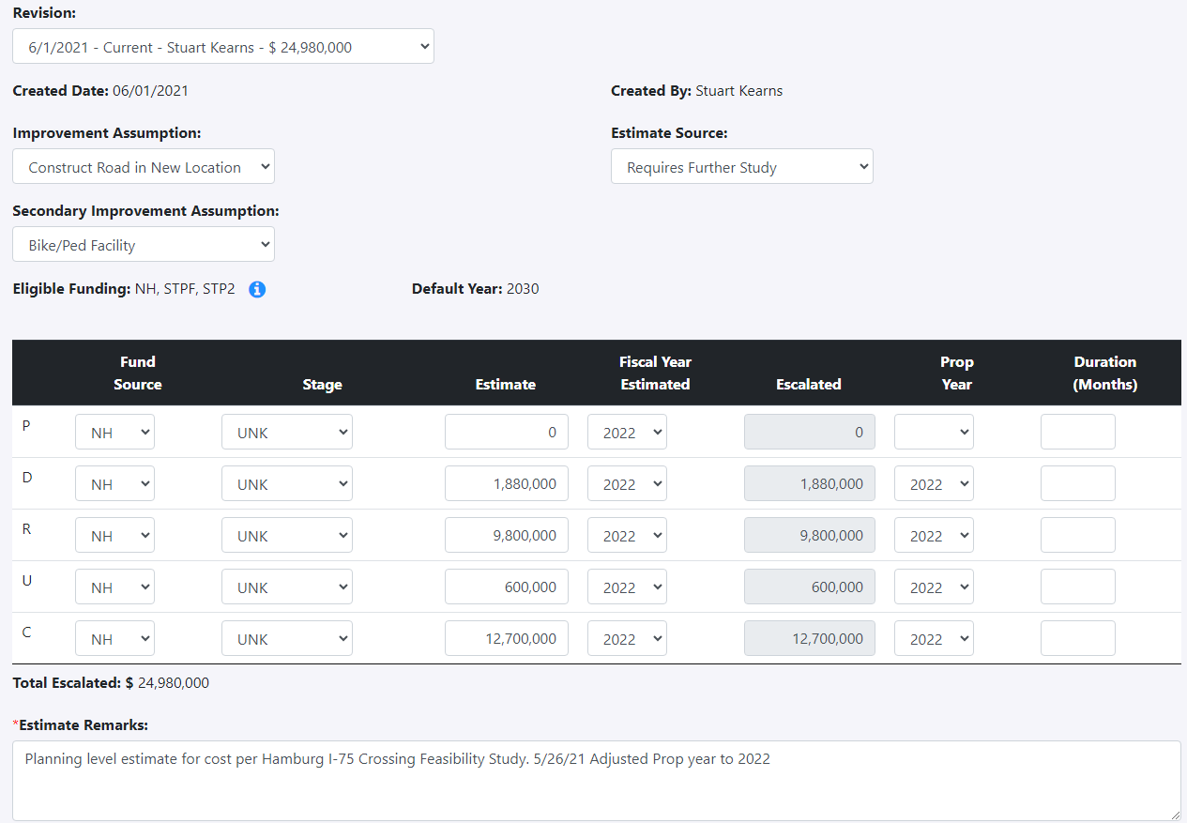
DOCUMENT ALL OF THIS

Slide 38
STRENGTHENING THE handoff

Slide 39
STRENGTHENING THE handoff
2+ Years?
Planning
Design
Scoping
PL&G
0%
5%
15%
30%

Slide 40
WHO: For Planning Study-related projects, Planning (District and Central Office) to stay involved until “Scoping” is complete at PL&G
WHY: Understand Planning’s thought process to meet Purpose & Need
Various points where “handoff” occurs
Better estimates = better for everybody
RESEARCH
ABSTRACT
DESIGN

Slide 41
Location “smell tests”

Slide 42
RESEARCH
ABSTRACT
DESIGN
PLANNING ESTIMATES

Slide 43
Revisit OFTEN

Slide 44
RESEARCH
ABSTRACT
DESIGN
REVISIT ESTIMATE

Slide 45
THE FUTURE
Coming Soon!
Still working out bugs with construction procurement

Slide 46
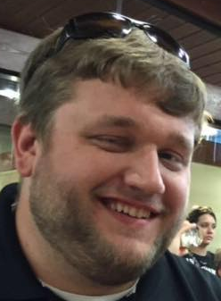
RESEARCH
ABSTRACT
DESIGN

Slide 47
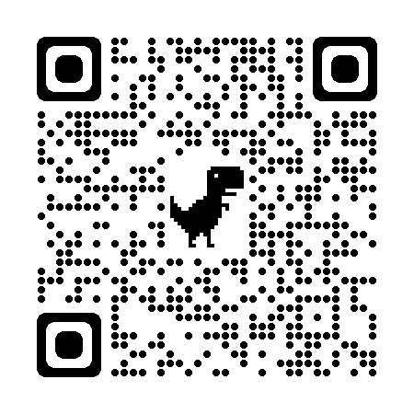
Special Thanks: Chris Van Dyke, Bryan Gibson, Jeff Jasper, and Bob Lewis

Slide 48
KEY TAKEAWAYS
Planning & Scoping Estimates are Difficult but Critical to KYTC success
Planning to stay involved on certain projects until PL&G
Location will “smell test” Planning estimates
Keep Goal of Estimate range in mind (e.g. -40% to +100%)
Better Estimates = Better for Everyone

Slide 49
Highway design updates

Slide 50
Highway Design Manual
Updates coming in late 2023
Mostly minor changes
Two major changes
Shoulder Superelevation
Intersection Control Evaluation (ICE)
Next update will occur when the new edition of the Green Book is released

Slide 51
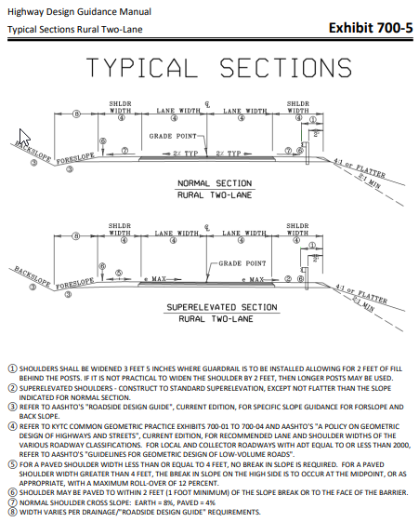
Shoulder Superelevation (Current)
Note 5 ) FOR A PAVED SHOULDER WIDTH LESS THAN OR EQUAL TO 4 FEET, NO BREAK IN SLOPE IS REQUIRED. FOR A PAVED SHOULDER WIDTH GREATER THAN 4 FEET, THE BREAK IN SLOPE ON THE HIGH SIDE IS TO OCCUR AT THE MIDPOINT, OR AS APPROPRIATE, WITH A MAXIMUM ROLL-OVER OF 12 PERCENT.

Slide 52
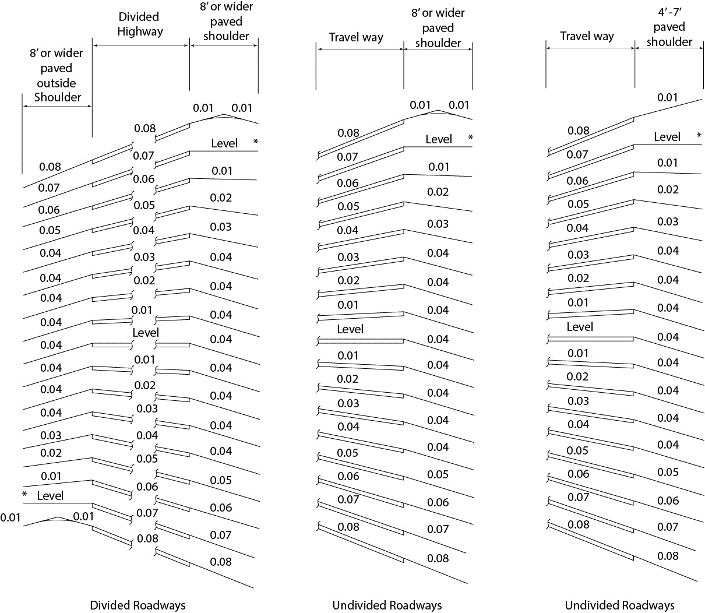
Shoulder Superelevation

Slide 53
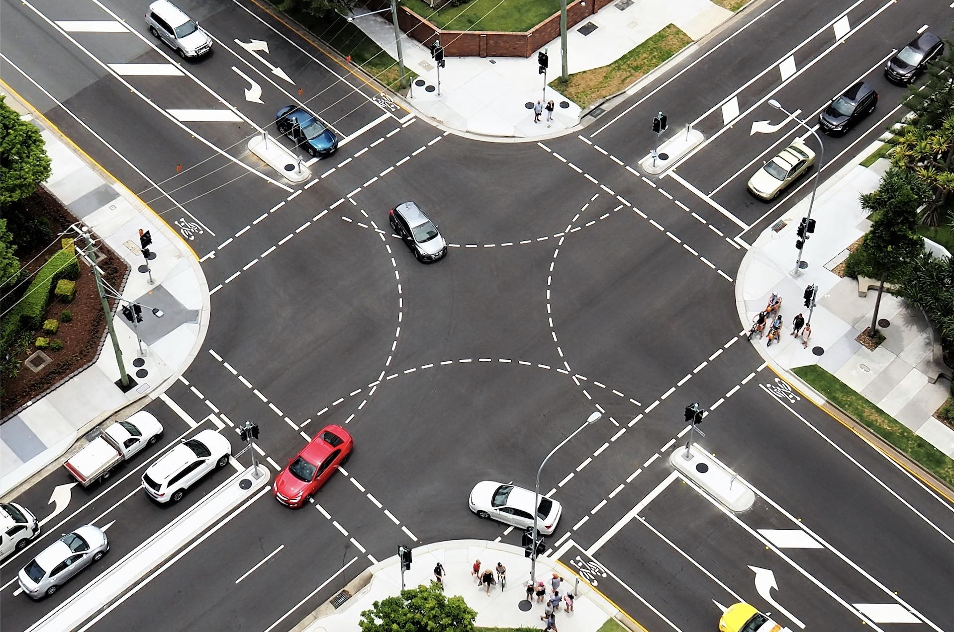
Intersection Control Evaluation
ICE
Currently In development
Goal is to implement in this round of HDM updates
Assist the project team in determining most appropriate Intersection type.
Will hear more about this on Day 3
Notes:
SPICE and CapX tools to analyze

Slide 54
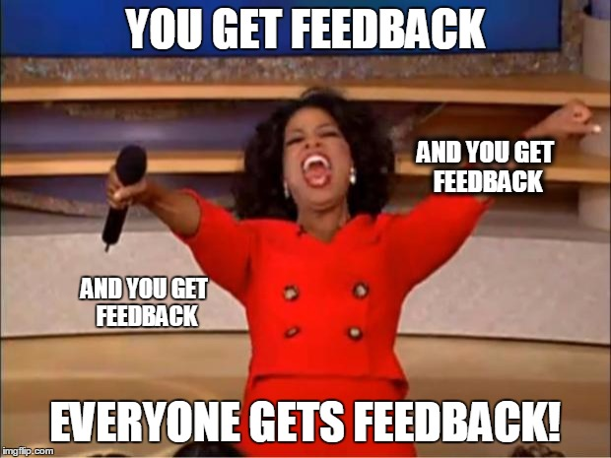
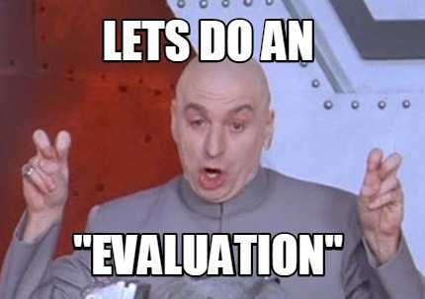
Consultant Performance Evaluations
Work in Progress
More robust
Besides the PM and Location Engineer other Divisions/Branches will provide input on the evaluation.
Eventually this will be part of the Professional Services Consultant Portal
The goal is to make this system useful and meaningful.

Slide 55
You know I have a plan for that road.
I have a plan
T. Layson
M. Pelfrey
Jeez! As long as it’s just a plan

Slide 56
If it was easy, it’d already be in Design.
I have a plan
Perry
De Witte

Slide 57
QUESTIONS/DISCUSSION
Steve De Witte, P.E.
TE Branch Manager – Strategic Planning
Stephen.DeWitte@ky.gov
502-782-5056
Patrick Perry, P.E., P.L.S.
TE Branch Manager – Roadway Design
Patrick.Perry@ky.gov
502-782-4925

